Slide 1

A
Presentation
on
“Online Chatbot based Ticketing System”
Presented by
Mr. Shriyash Amarnath Patil Mr. Tanmay Dinesh Nagawade
Mr. Narendra Nanasaheb Khamkar
Ms. Vaishnavi Santosh Gopale Mr. Suraj Ramdas Pansare
Under the guidance of
Dr. Sofiya Mujawar
Registration No. - NCRISES2024-B-G048 Department of Information Technology School of Engineering & Technology
D.Y. Patil University, Pune. Academic Year 2024-25.
1

Slide 2
Presentation Outline
Introduction
Literature Survey
Methodology(Hardware & Software)
Schematic
Flowchart /Algorithm
Simulation Results (if any)
Applications
Conclusions
References
2

Slide 3
Introduction
The project aims to design and develop an intelligent ticketing system using a chatbot interface. The system will be capable of understanding user queries, providing information, and automating ticketing processes
3

Slide 4
Introduction (Cont’d…..)
1
Need for Automation
Traditional ticketing systems often involve manual processes, which can be time-consuming and prone to errors.
2
Enhanced User Experience
A chatbot interface can provide a more user-friendly experience, allowing customers to access ticketing services easily.
3
Real-time Support
The chatbot can provide instant support to users, addressing inquiries and resolving issues in real-time.
4

Slide 5
Literature Survey
S.No | Paper Title & Authors | Methodology | Key Contributions | Limitation s | Year
1. | Keystroke- Level Model to Evaluate Chatbot Interface for Reservation System | Literature review of chatbot architectures for customer support. Comparison of frameworks like Dialog flow and Rasa. | Provides a high- level overview of chatbot architecture for automating ticket creation and management in customer support systems. | Lacks detailed implementatio n and real- world application data. | 2019
2. | Leveraging AI Chatbots for IT Help Desk Automation: A Case Study | AI-driven chatbot implementation for automating help desk functions, including ticket generation and query resolution. | Demonstrates the use of NLP for classifying and routing support tickets, improving efficiency in ticket handling. | No focus on the chatbot interface or user interaction model. Limited to ticket classification. | 2019
3. | Design and development of ticket booking system using smart bot | The main use of the chatbot on the website is to respond to the user’s queries. For instance, the chatbot in messenger, and telegram bot. it is going to take text as input. once the | Provides a complete framework from chatbot design to deployment, with a focus on real-time ticket handling. | Primarily focused on architecture without extensive performance benchmarks. | 2022
5

Slide 6
S.No | Paper Title & Authors | Methodology | Key Contributions | Limitations | Year
4. | Proposing Tourism Chatbot by employing the wisdom of crowds in building its knowledge base | The methodology used in this study was quantitative with the main activity was by conducting online questionnaires with closed- ended questions. The sampling method was non probabilistic with n=40 in the initial attempt | Detailed insights on how chatbots can improve efficiency in ticket handling and customer interaction processes. | Based on a single case study, so generalizability to other industries may be limited. | 2022
5. | Enhanced Opened and distance learning using AI-Powered chatbot a conceptual framework | The proposed system will make use of bot Rule-based chatbots, AI Chatbots and Multinomial Naive Bayes algorithm. The rule- based bot completes scripted actions based on keywords and guided by a decision tree, a list of predefined options leading to the desired response are provided to the learner | Proposes AI chatbot solutions that reduce human intervention in help desk ticketing systems and automate ticket lifecycle processes. | Focuses on IT-specific help desk automation without generalization to other support systems. | 2022
6. | Intelligent Agent based Ticket Booking System | This section discusses about the methodology used in developing the proposed system. The methodology chosen is | Highlights user experience challenges in using chatbots for IT ticketing and | Limited scope of chatbot functions— focused mainly on usability rather than full integration | 2024
6

Slide 7
Methodology
Hardware :-
Windows 10/11, i3/i5 Core Processor, Internet
Software:-
VSCode, MYSQL, Browser. Technologies:-
HTML, CSS, Javascript, Python, Machine Learning, MYSQL.
7

Slide 8
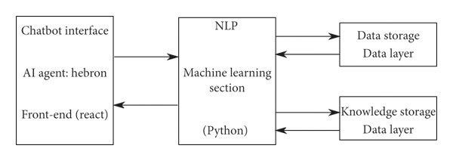
Block Diagram
(Html
, CSS)
8

Slide 9
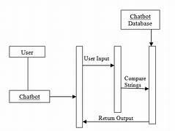
Schematic -
9

Slide 10
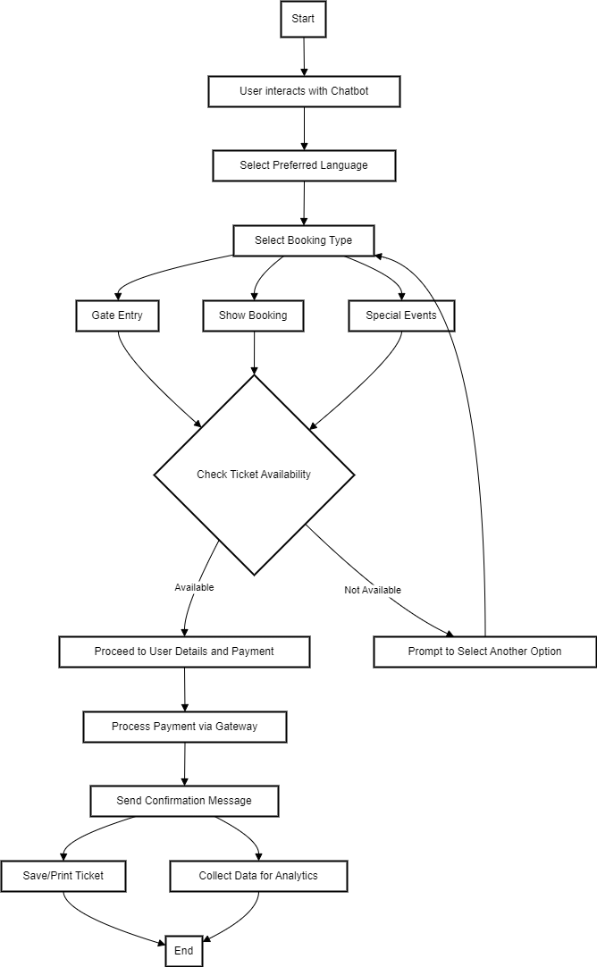

Flowchart / Algorithm
10

Slide 11
Applications
Event Ticketing
Streamline the purchase of tickets for concerts, sporting events, and other entertainment.
Travel Booking
Seamlessly reserve flights, hotels, and rental cars through an intuitive chat interface.
1
2
Public Transportation
Easily purchase and manage public transportation tickets, from subway to buses.
Customer Service
Provide instant and personalized support to customers, resolving issues quickly.
3
4
11

Slide 12
Conclusion
1
2
3
4
Efficiency
Chatbot-based ticketing systems
Personalization
Tailored recommendations
Accessibility
Easy-to-use chat interfaces are
Cost Savings
Automation reduces operational costs for
simplify ticket purchase and management, saving time and effort.
based on user preferences and past purchases enhance the experience.
accessible to a wide range of users, regardless of technical skills.
ticketing organizations, improving profitability.
12

Slide 13
References
1. Chatbot Frameworks and Architecture:
Paper Title: "A Survey on Chatbot Implementation in Customer Support
Systems"
Authors: Abdellatif El Meslouhi, Mohamed Khamlichi, Mohamed
Abderrahim.
2. Natural Language Processing (NLP) for Ticket Classification:
Paper Title: "Automating IT Support Ticket Categorization with Machine
Learning"
Authors: Chirag Patel, Rakesh Sharma, and Seema Shah.
3. End-to-End Chatbot Design for Customer Service:
Paper Title: "End-to-End Framework for Building Conversational Agents for
Customer Support"
Authors: Karthik Ramesh, Nikhil Choudhary.
4. Integration of Chatbots in Business Processes:
Paper Title: "Chatbots in Business Processes: A Case Study on Ticketing
Systems"
Authors: Marco Pichler, Josef Dorn, and Astrid Böhm.
13

Slide 14
Thank you!
15

